Slide 1
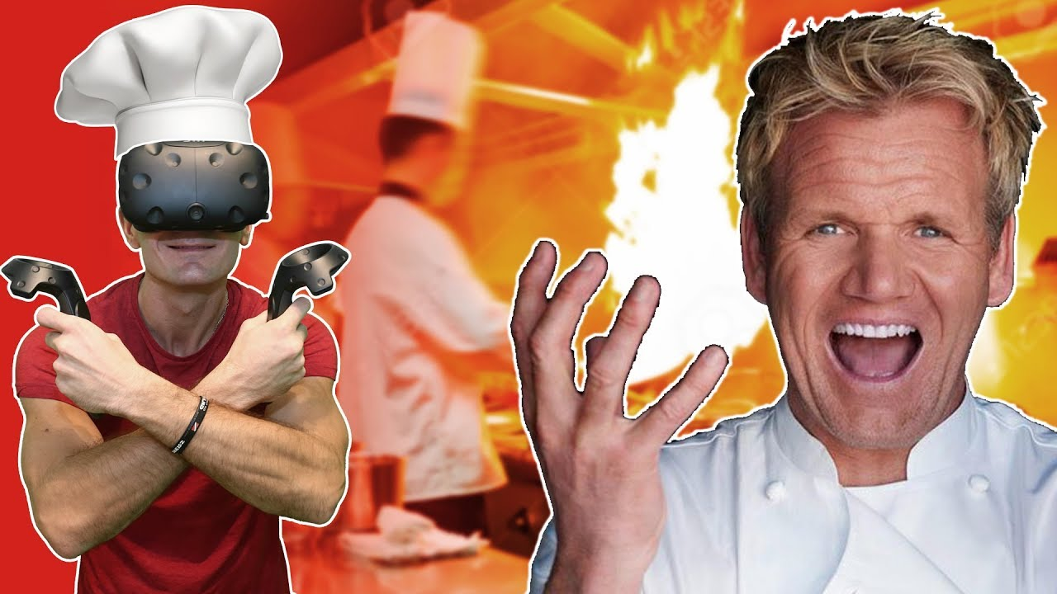
Cooking Simulation Idea in VR

Slide 2
Purpose
To provide newly hired restaurant employees a training environment for cooking and organizing food for preparation on the actual job
Real cooking can be a mess. Why not have a little fun in a virtual world where you can afford to screw up all you want?

Slide 3
Three key features

Slide 4
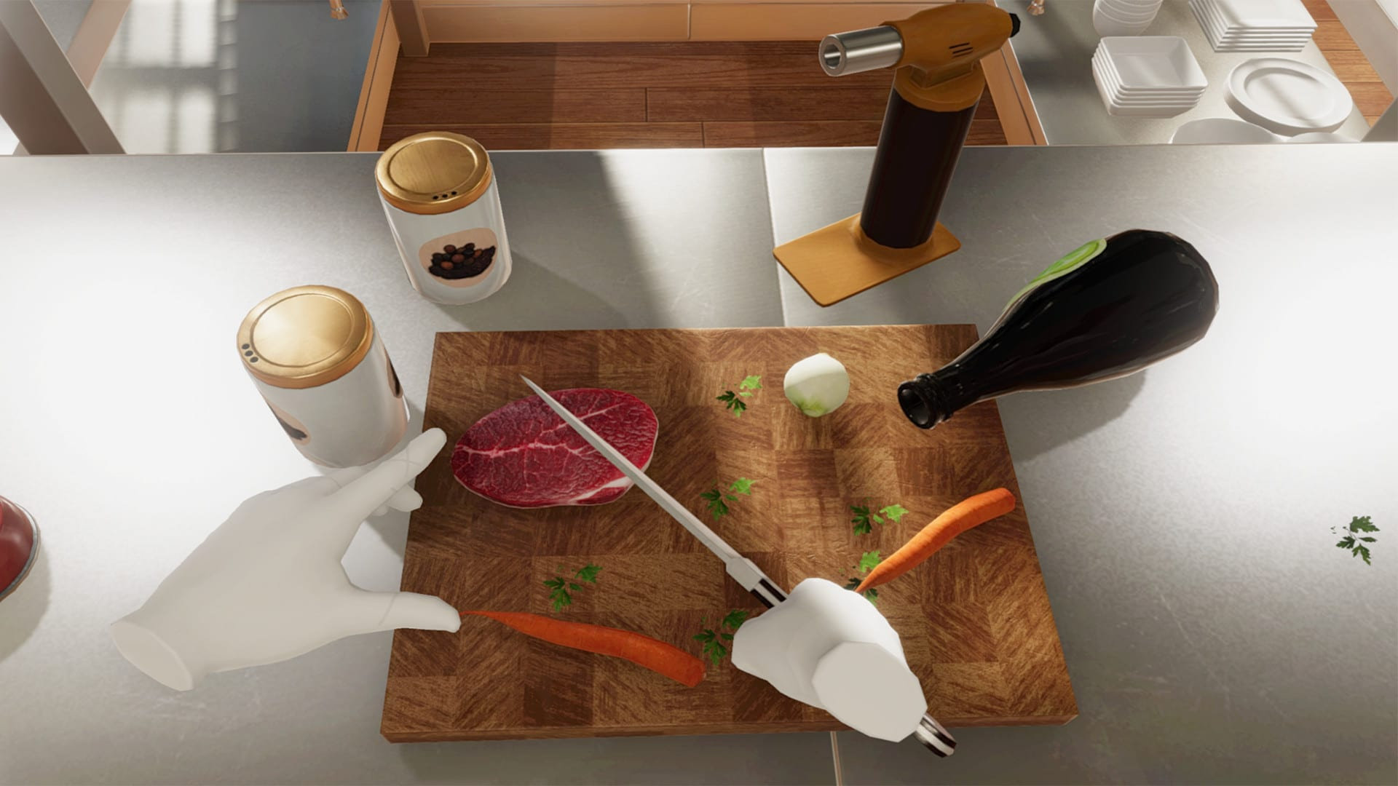
User
players need to cook with both arms and use steering based travel techniques to maneuver around the kitchen
players need to be able to cook a particular recipe within a particular time frame

Slide 5
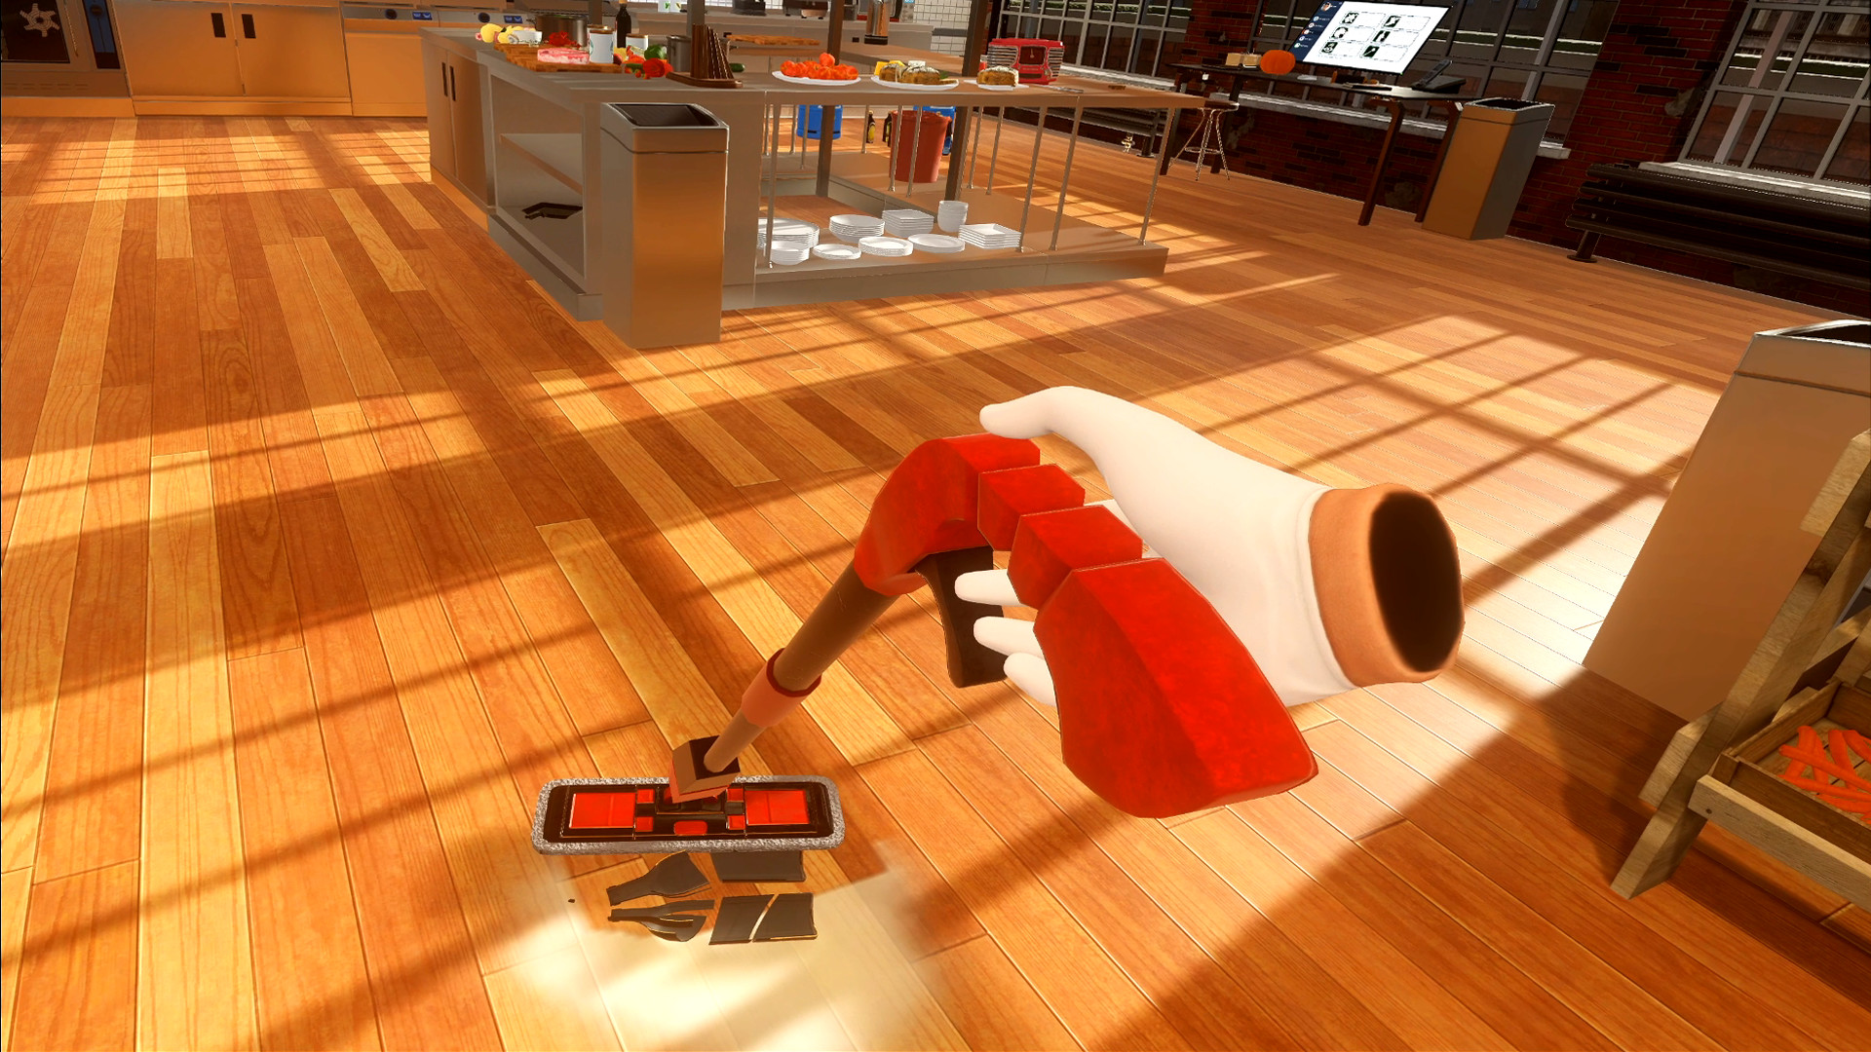
Scenario
players need to multitask (e.g. be able to do other tasks around the kitchen in addition to cooking such as washing the dishes, mopping the floors, catering the guests)

Slide 6

Backend
We may have multiple chefs in the kitchen doing productive work
We need a database that stores the performance stats of each player

Slide 7
Required Resources
Hardware
Any vr headset that works in unity will do (e.g. oculus quest II)
Personnel
Three additional people (including me makes a total of four on the team)
Two back-end developers and the other two will be mainly working and unity
Asset
Kitchen environment that is big enough to fit at least four players
Food and beverages
Recipe book
Skills
Integrate VR headsets, their inputs and functionality with Unity
Object-oriented programming in C#
Decision making on the types of manipulation and steering techniques to use

Slide 8
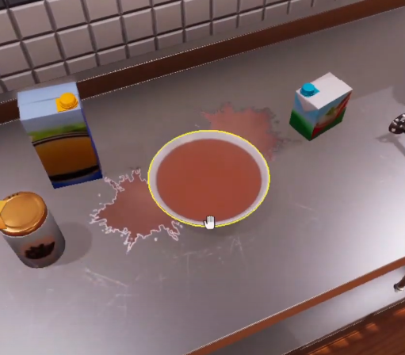
Novel idea in this project
We can reverse time when let's say, something is overcooked as a way to forgive mistakes
We can also have an anti-gravity feature to prevent dropping fragile objects on the floor and spilling food and drinks

Slide 9
Links
https://www.youtube.com/watch?v=h80Ya3CSdV8
https://www.youtube.com/watch?v=N4Rj-ka9RRk

